Slide 1



MERN – ES6 + React
Module 01

Slide 2
Outline
Module 08
Understanding concepts of Functions
Understanding concepts of Arrays
Understanding concepts of Objects
Understanding concepts of For Loops

Slide 3
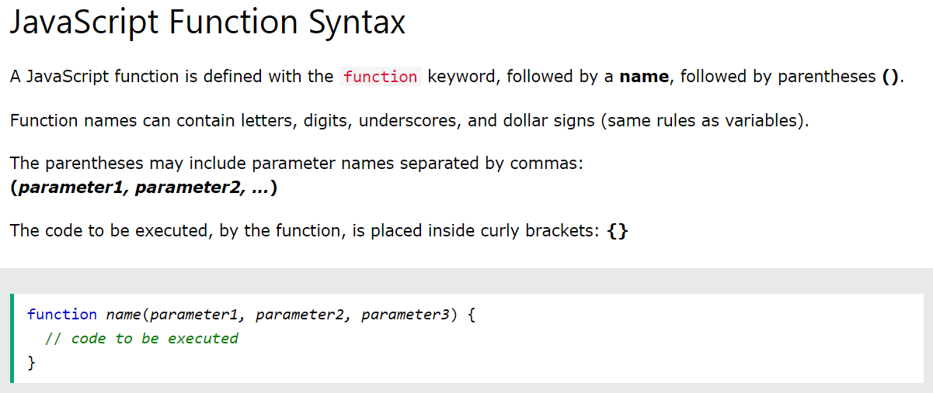
JavaScript Functions
A JavaScript function is a block of code designed to perform a particular task.

Slide 4
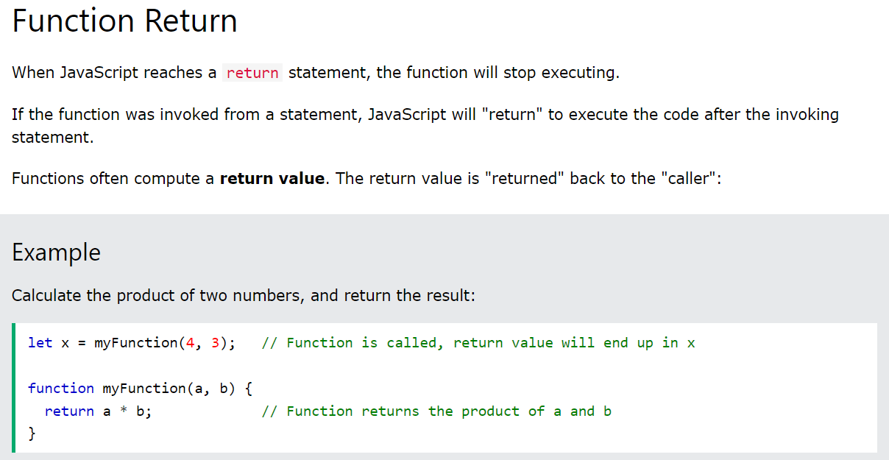
JavaScript Functions
A JavaScript function is a block of code designed to perform a particular task.

Slide 5
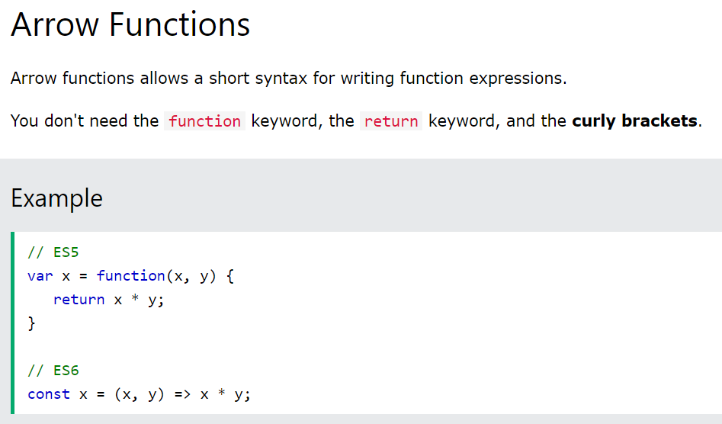
JavaScript Functions
A JavaScript function is a block of code designed to perform a particular task.
JavaScript Arrow Function (w3schools.com)

Slide 6
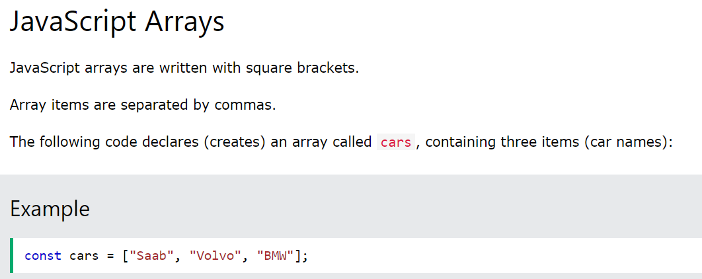
JavaScript Arrays
JavaScript basics

Slide 7
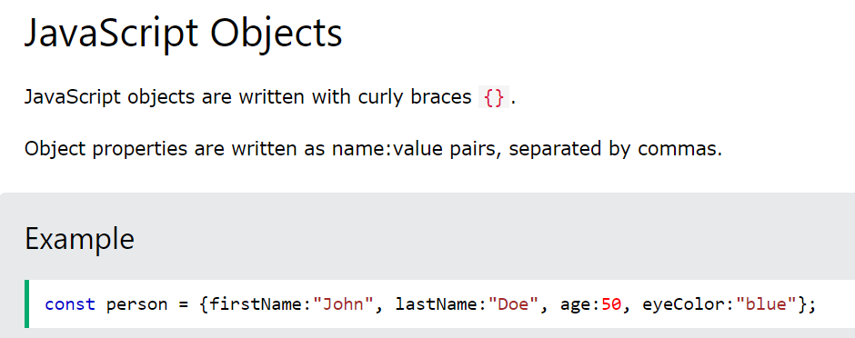
JavaScript Objects
JavaScript basics

Slide 8
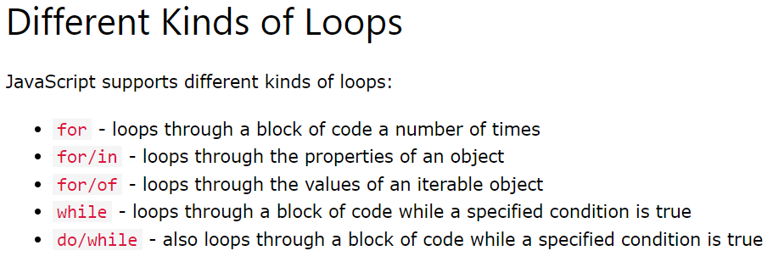
JavaScript Loops
JavaScript basics

Slide 9
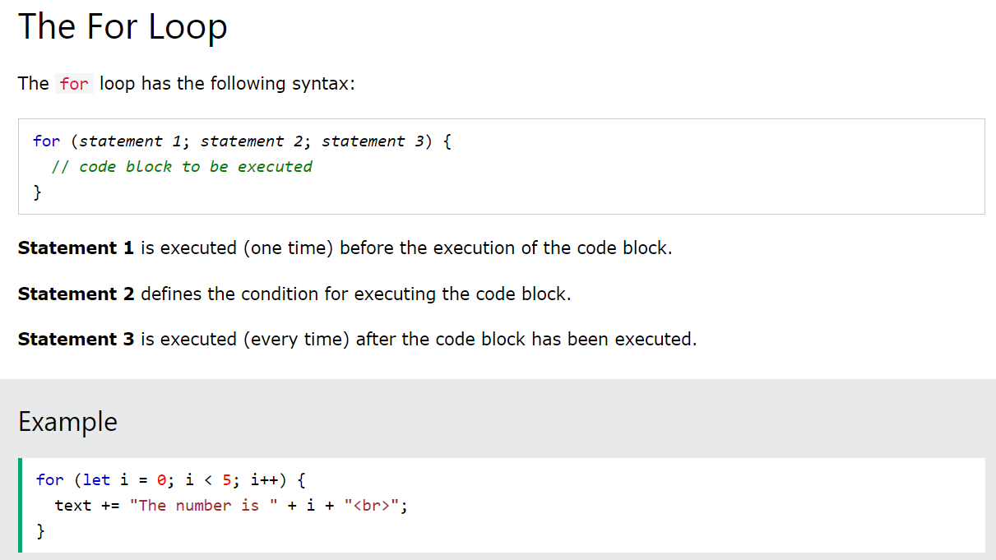
JavaScript Loops
JavaScript basics

Slide 10
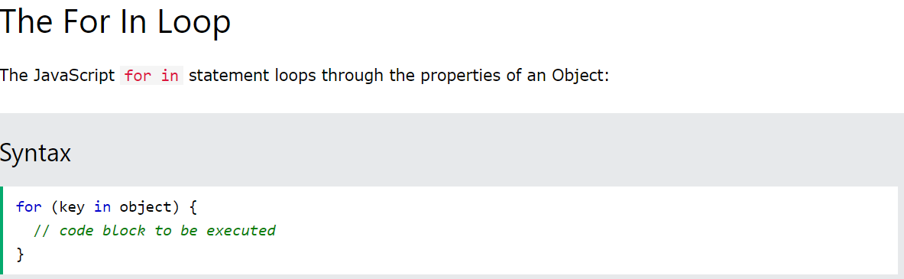
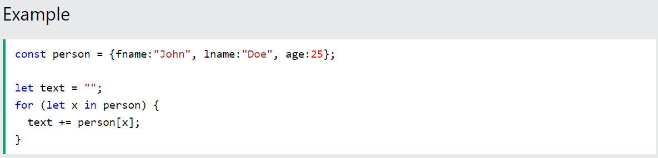
JavaScript Loops
JavaScript basics

Slide 11
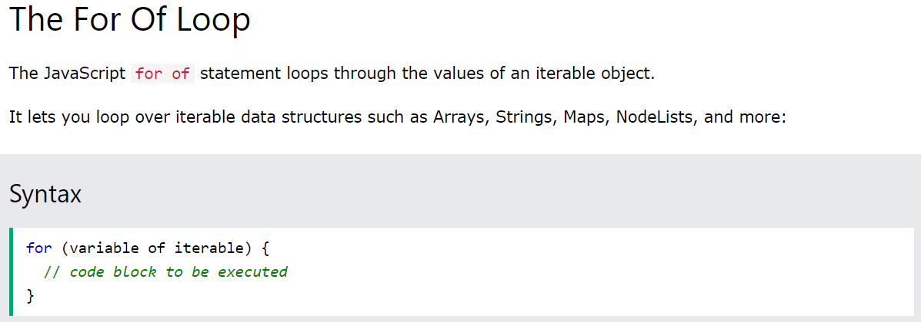
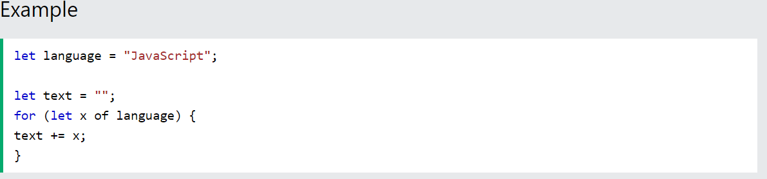
JavaScript Loops
JavaScript basics

Slide 12
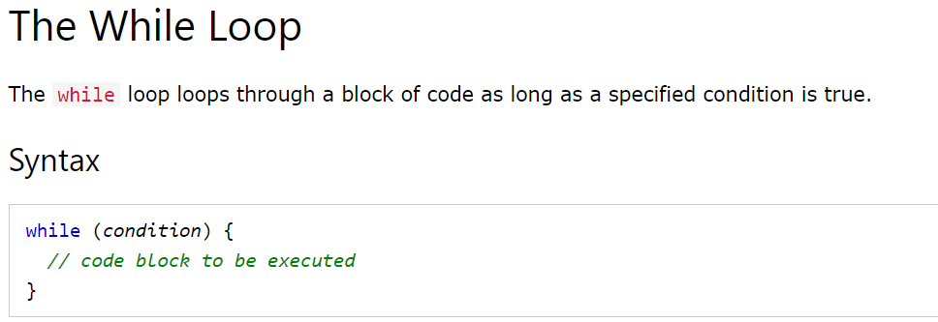
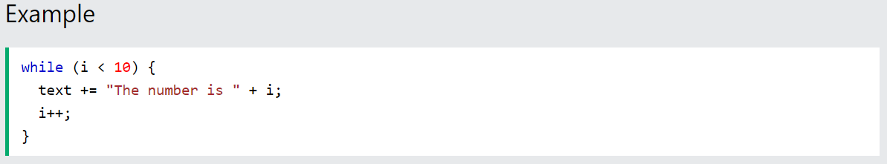
JavaScript Loops
JavaScript basics

Slide 13
Summary
Module 08
Understanding concepts of Functions
Understanding concepts of Arrays
Understanding concepts of Objects
Understanding concepts of For Loops

